Slide 1
String Project

Slide 2
Our team
Name, class and E-mail: | Role:
Dimitar Milenov Kalchev - IX A | Manager, Developer
Kristian Asenov Milanov – IX V | Developer
Kaloyan Nikolaev Andrikov - IX G | Designer, Administrative worker
Teodor Boyanov Dimov – IX B | Designer, Developer

Slide 3
About our project
We have created a C++ application that gives the opportunity to the kids to play our game called hangman.
The game is simple we have put random words and the person playing the game needs to guess the word.
The player of the game has the right to make 6 mistakes, every time he makes a mistake, a part of the hangman appears.

Slide 4



Used Technologies

Slide 5
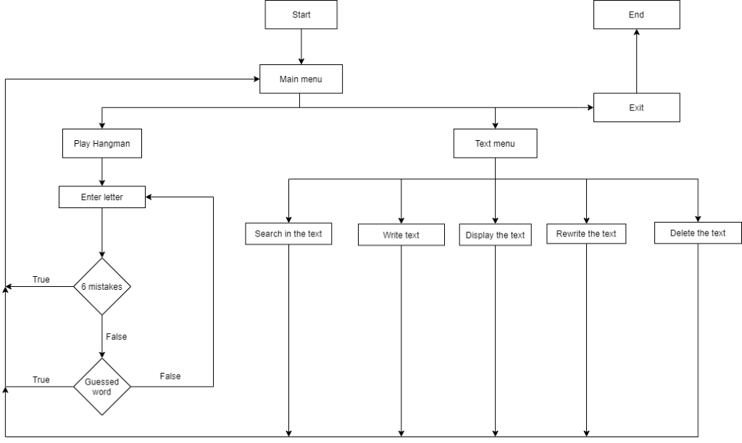
Block Scheme

Slide 6
Future improvement plans
Further improve the general quality of the program.
Make the user interface visually more appealing.
Simplify the program, so it is easier to work with.
Add more options to the program.

Slide 7

Any questions?

Slide 8
Thank you for the attention!

